Slide 1
NLP Project Presentation
Calibrating posterior estimates in NLP classifiers during training
Shirin Goshtasbpour , Rishabh Singh
Notes:
Hello everyone, in this presentation we will be presenting our project on Calibrating posterior estimates in NLP classifiers during training.

Slide 2

DNN rocks?
Deep Neural Networks provide highly accurate label prediction
High classification accuracy ≠ good posterior estimation quality [1]
Overconfident predictions and misleading uncertainity
Model “knows what it doesn’t know”
Model Calibration
Notes:
1. Deep learning has proven to be tremendously attractive for researchers in almost every field given the highly accurate predictions.
2. However, for some fields such as NLP, representing model uncertainty is of crucial importance.
3. Deep Neural Networks are poor at quantifying predictive uncertainty, and tend to produce overconfident predictions, which can be harmful or offensive in NLP
applications .
4. Thus, it is imperitive that the the model should know what it does not know so that they can be deployed in practice
5. Model calibration essentially aims to get posterior probability estimations that reflect the true probability of the classes

Slide 3
But how to calibrate?
Posterior Calibration
Post-processing to re-learn appropriate distribution from validation set, apply it to test set
Poor generalization due to small number of samples in calibration set
Calibrate while training [2]
Notes:
But how to calibrate?
Posterior calibration is one such method to do that. Such methods generally rescale the posterior distribution predicted from the classifier after training.
They re-learn an appropriate distribution from a held-out validation set and then apply it to an unseen test set.
However, due to small number of samples in the calibration set, these post-hoc methods tend to have poor generalization to newer data.
One straight away solution is to include the calibration within the training itself, but does it always work? Let's find out.

Slide 4

How much training data?
Existing training methods use Histogram Binnning [3]
Verifiable calibration error but sample inefficient.
B- bins and e- calibration error: O(B/e²)
Platt-scaling [4] needs O(1/e²) samples
Calibration error is not measurable.
Notes:
Existing methods which calibrate while training use Hitogram binnning for estimating the empirical probablity. These methods although provide a measurable estimate of calibration error, they require too many samples. For instance, to achieve a calibration error e with a B bins, the number of samples requires in the order of b/e_square. Another popular method, Platt-scaling, can achiver the same error in rather lesser number of samples, but, we don't have a method to measure their calibration error. So, is this a deadlock?

Slide 5
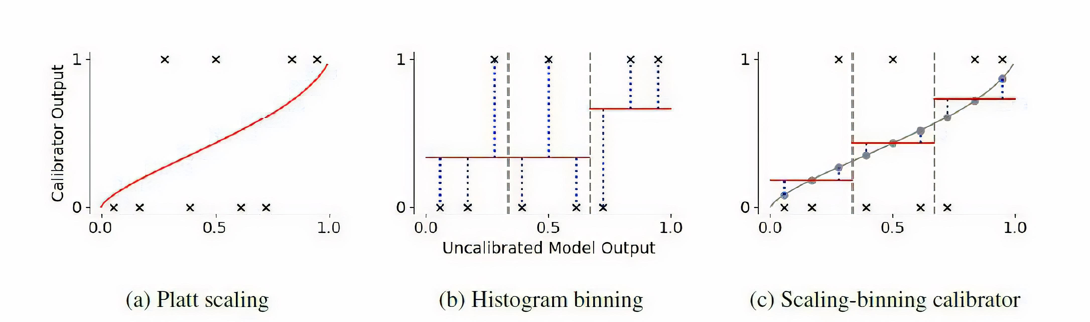
Best of both worlds
Lower estimation error
Improved sample complexity: O(B+ 1/e²)
Measurable calibration error
Src: Verified Uncertainty Calibration, Kumar et al.
Notes:
Not really, we combine the best of both worlds.
Here we see a visualization of the three recalibration approaches. The black crosses are the ground truth
labels, and the red lines are the output of the recalibration methods.
Platt Scaling fits a function to the recalibration data, but its calibration error is not measurable.
Histogram binning outputs the average label in each bin.
The scaling-binning calibrator fits a function g to the recalibration data and then takes the average of the function values ( denoted by the gray
circles) in each bin.
The function values have lower variance than the labels, as visualized by the
blue dotted lines, which is why our approach has lower variance.
And lesser number of samples in the order of B + 1/e_square along with verification guarantees on calibration error.

Slide 6
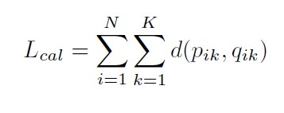
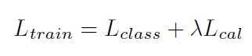
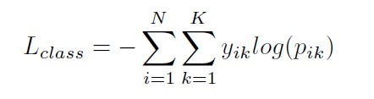
Our Method
Minimize L_{train}
L_{class}: classification loss eg. Cross entropy
L_{cal}: calibration loss, eg. mean squared error, KL divergence
Estimate empirical probability q by Platt-Binning method
Notes:
We build upon the same motivation
Given a trainingset D with K classes and N samples, we
minimize the loss Ltrain. It is composed of two losses:
Lclass is the classification loss (for eg. cross-entropy)
based on the predicted probability pik updated during training
for sample i and class k
Lcal is the calibration loss which acts as a regularizer.
It essentially tries to minimize the difference between the
updated probability p and true posterior probabilities q via a
distance function d
The question is- how do we estimate empirical probablilty Q?

Slide 7
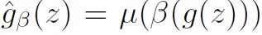
Platt-Binning Calibrator
Fit g :
Choose bins for equal number of g(z_{i}) in T to land in each bin I_{j}
Discretize g: output average g value in each bin
Notes:
We do it by Platt-Binning calibrator:
Given a recalibration data T of size n
We fit g from a family of function G such that the squared error between lables y and prediction z is minimum
We then choose the bins so that an equal number of g(zi) in T land in each bin Ij where j ranges from {1, . . . ,B}—this uniform-mass binning scheme [10] as opposed to
equal-width binning [9] is essential for being able to estimate the calibration error
Finally we Discretize g, by outputting the average g value in each bin. If you remember, these g values are the gray circles. Show them.

Slide 8
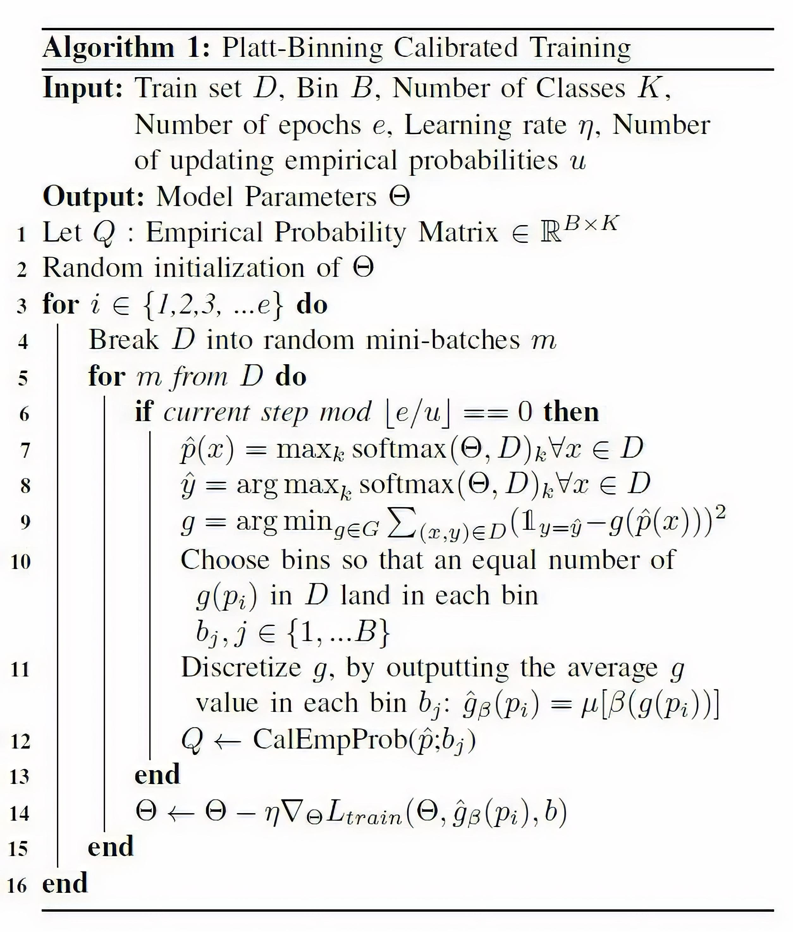
Platt-Binning Algorithm
Notes:
Here we formally define our Platt-Binning algorithm based on the discussion so far. We will encourage the viewers to pause here for reflecting more on the details. Due to time constraints, we will continue with the rest of the presentation.

Slide 9
Experiment
Our methods:
Plattbintop: calibrator for the most confident prediction of the classifier
Plattbin: separate Platt scaler & histogram binning for each class in a one-vs-all manner
Dataset: xSLUE
Baselines
MLE: maximum likelihood training without calibration
Platt scaling: post-hoc calibration of posterior estimations of MLE classifier using Platt scaling
PosCal: end-to-end training calibration using histogram binning [2]
Notes:
We now describe our experimental setup.
We report performance of two variants of our proposed method ….. read lines in the slide
For the benchmark, we use xSLUE: contains classification benchmark on different types of styles such as a level of humor, formality and even demographics of Authors
For baselines, we compare with (read slides)

Slide 10
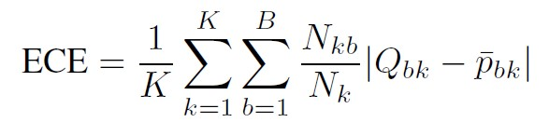
Evaluation
Expected Calibration Error (ECE) [5]
Miscalibration: difference in expectation between confidence and accuracy
ECE: approximates it by partitioning predictions into B equally-spaced bins and taking a weighted average of the bins’ accuracy/confidence difference
Popular empirical metric to measure calibration

Slide 11
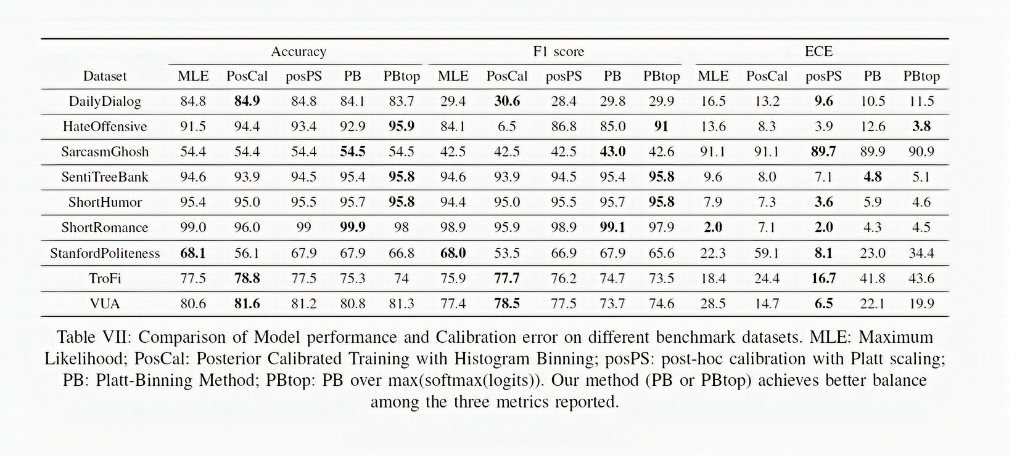
Results
Notes:
1. our method outperforms
MLE and Poscal on approximately 50% of the
datasets we tested in terms of both model performance and
calibration error.
2. cases such as DailyDialog, SentiTree-
Bank and ShortHumor, the achieved reduction in ECE is
Significant
3. this reduction has
not compromised with the model performance
4. cases like SentiTreeBank and ShortRomance even witness
a significant improvement in the performance of the model
when ECE is reduced
5. This observation proves the efficacy
of our method in maintaining a perfect balance between
model performance and model uncertainity

Slide 12
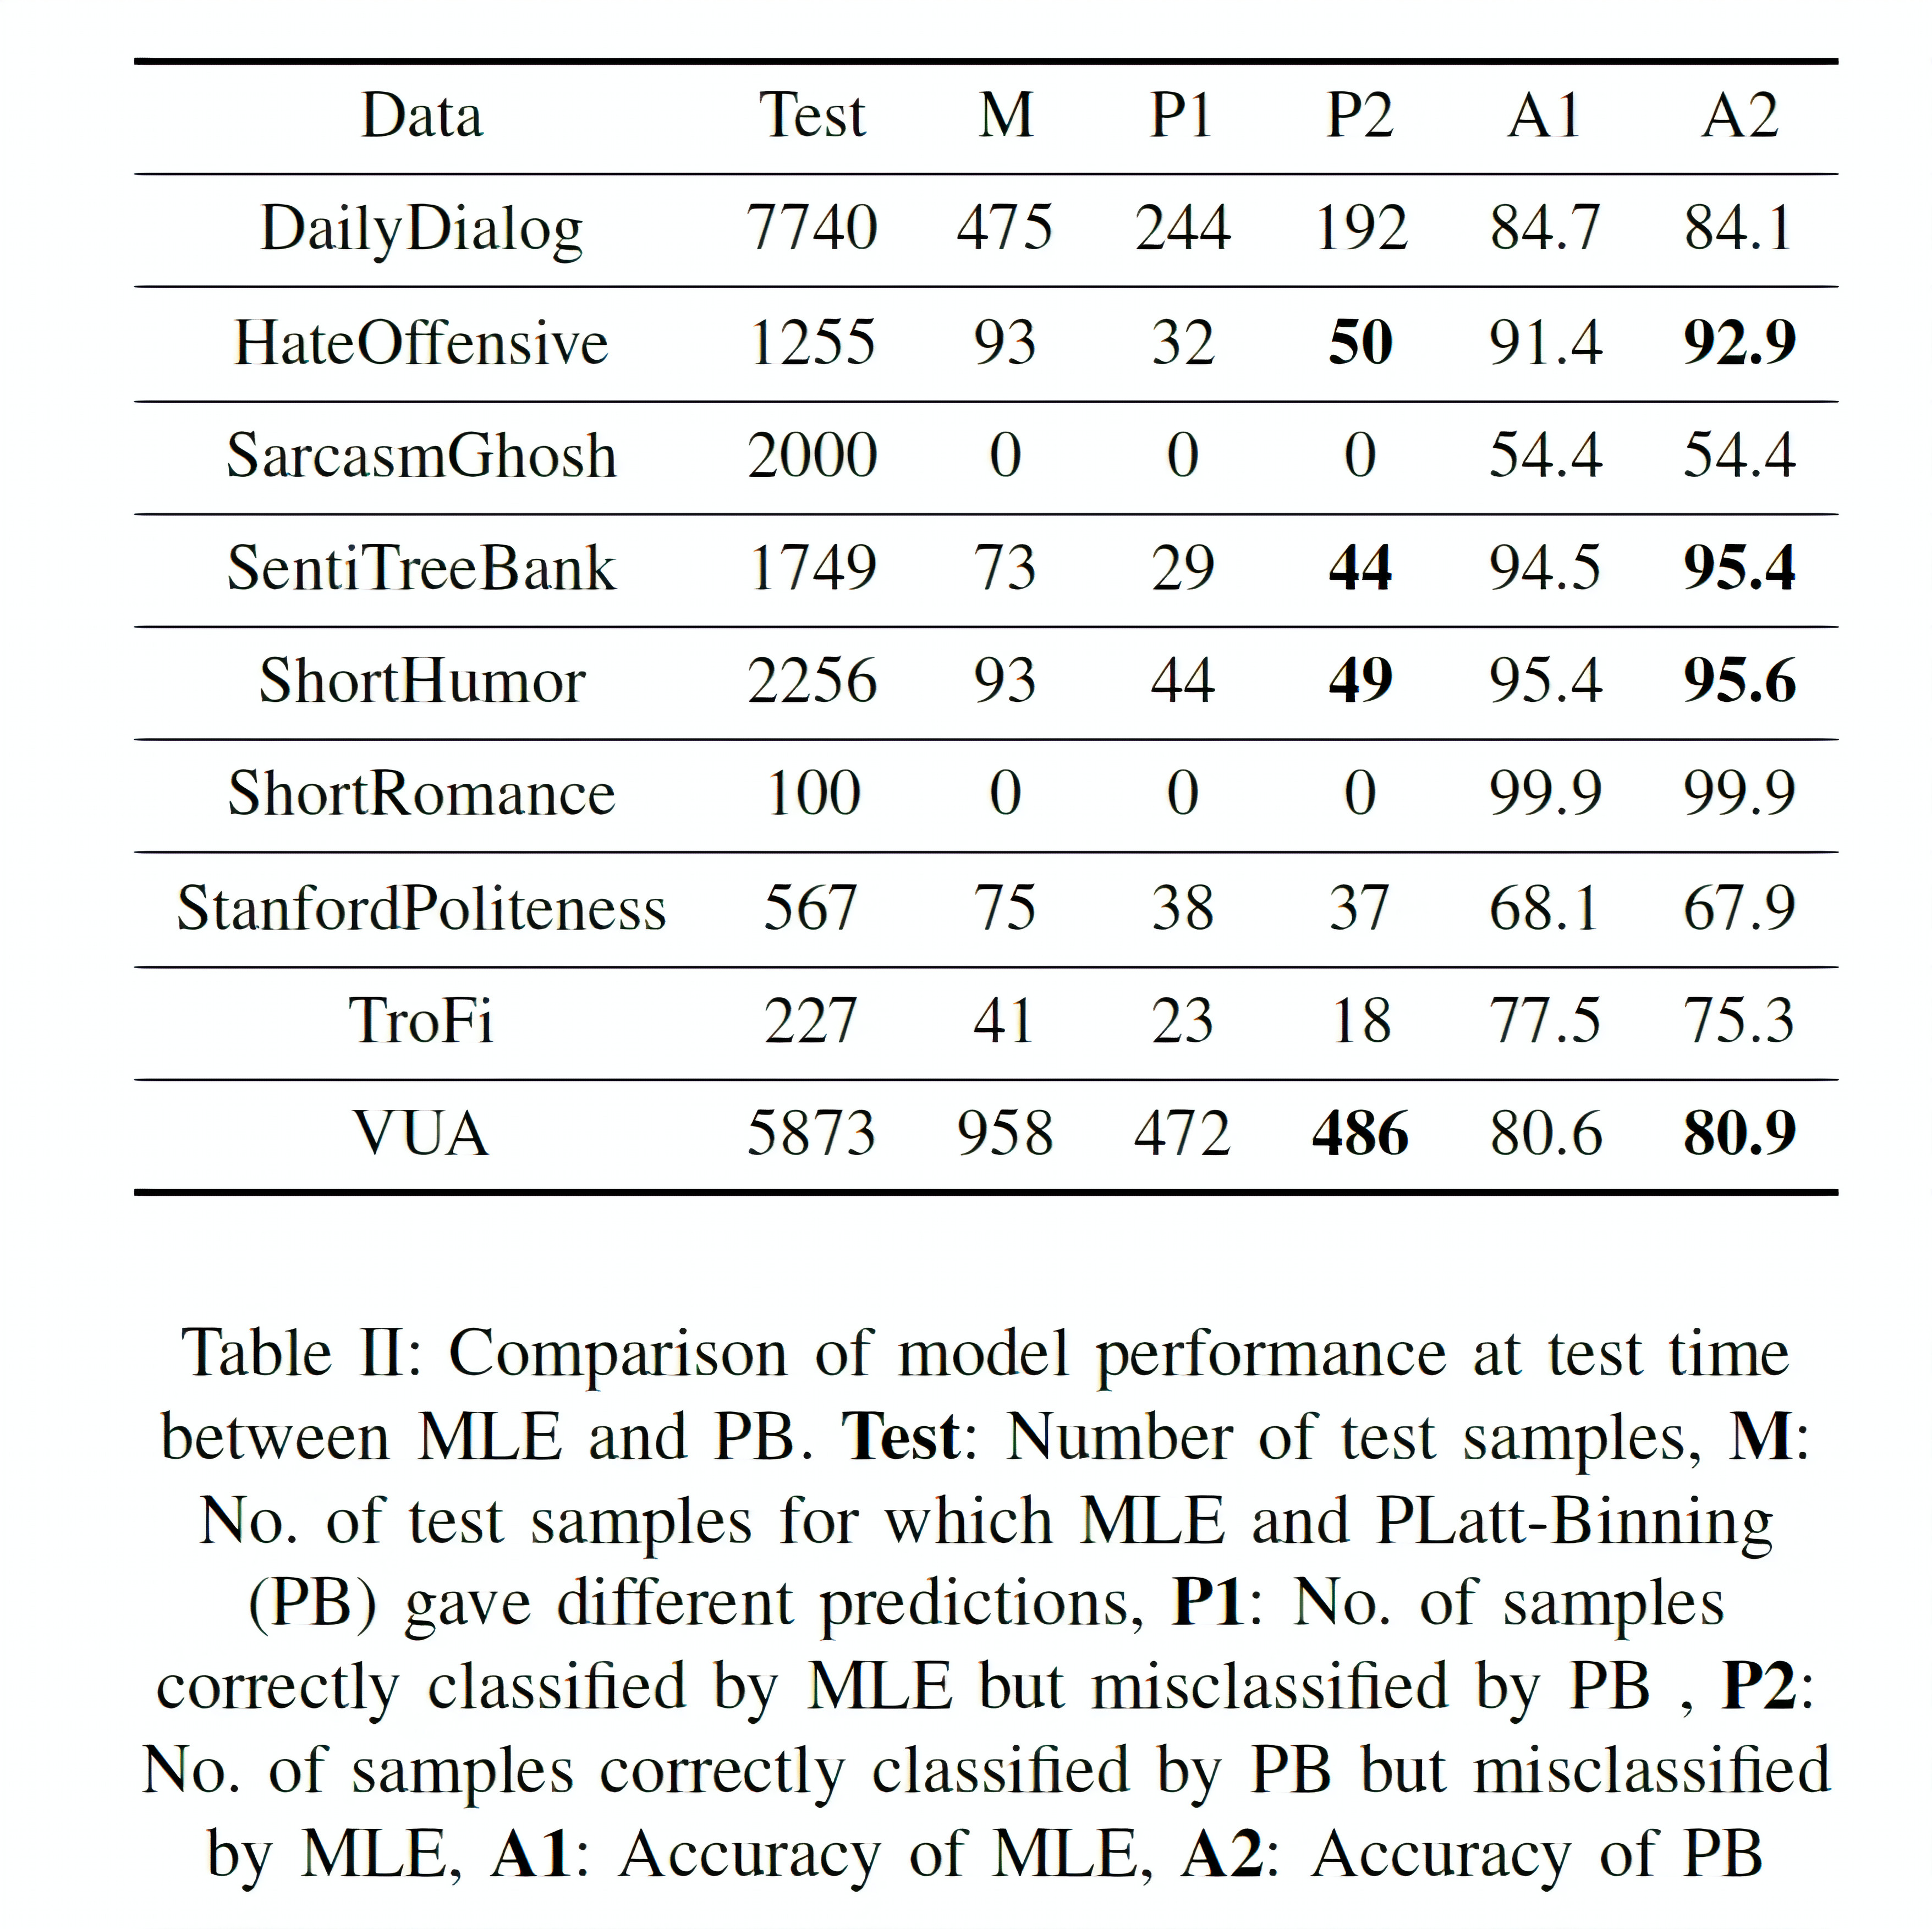
Comparable performance between MLE and PB
Disagreements in predictions for only a small fraction of the test set
In 6 out of 9 dataset, PB demonstrates superior or similar performance
Difference is insignificant compared to the total size of the test set for the rest
PB generalizes well while reducing calibration error
Notes:
Explain slides

Slide 13
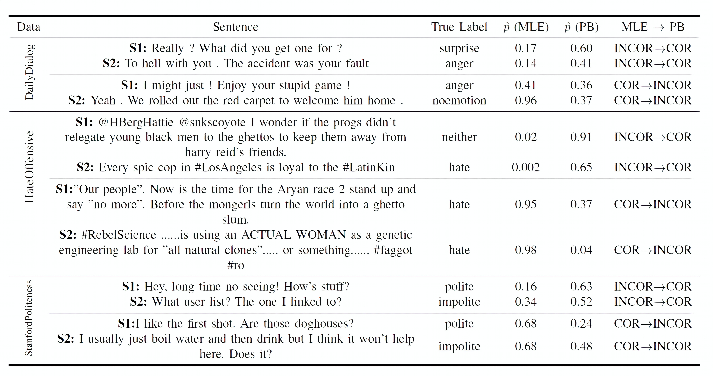
Qualitative analysis
Notes:
StanfordPoliteness dataset, the
level of politeness (e.g., “Hey!” in S1) or arrogance (e.g.,
“What?” in S2) indicated on phrases is not captured well by
MLE, so it predicts the incorrect label while PB gives a correct
Prediction.
However, for the rest two cases, MLE gives
confident correct predictions taking into account phrases
such as ”like” in S1 or a slightly difficult example in S2
but PB fails (only slightly in S2 though) to give correct
Predictions
From our manual investigation
above, we find that statistical knowledge about posterior
probability helps correct ^p while training PB, so making ^p
switch its prediction

Slide 14
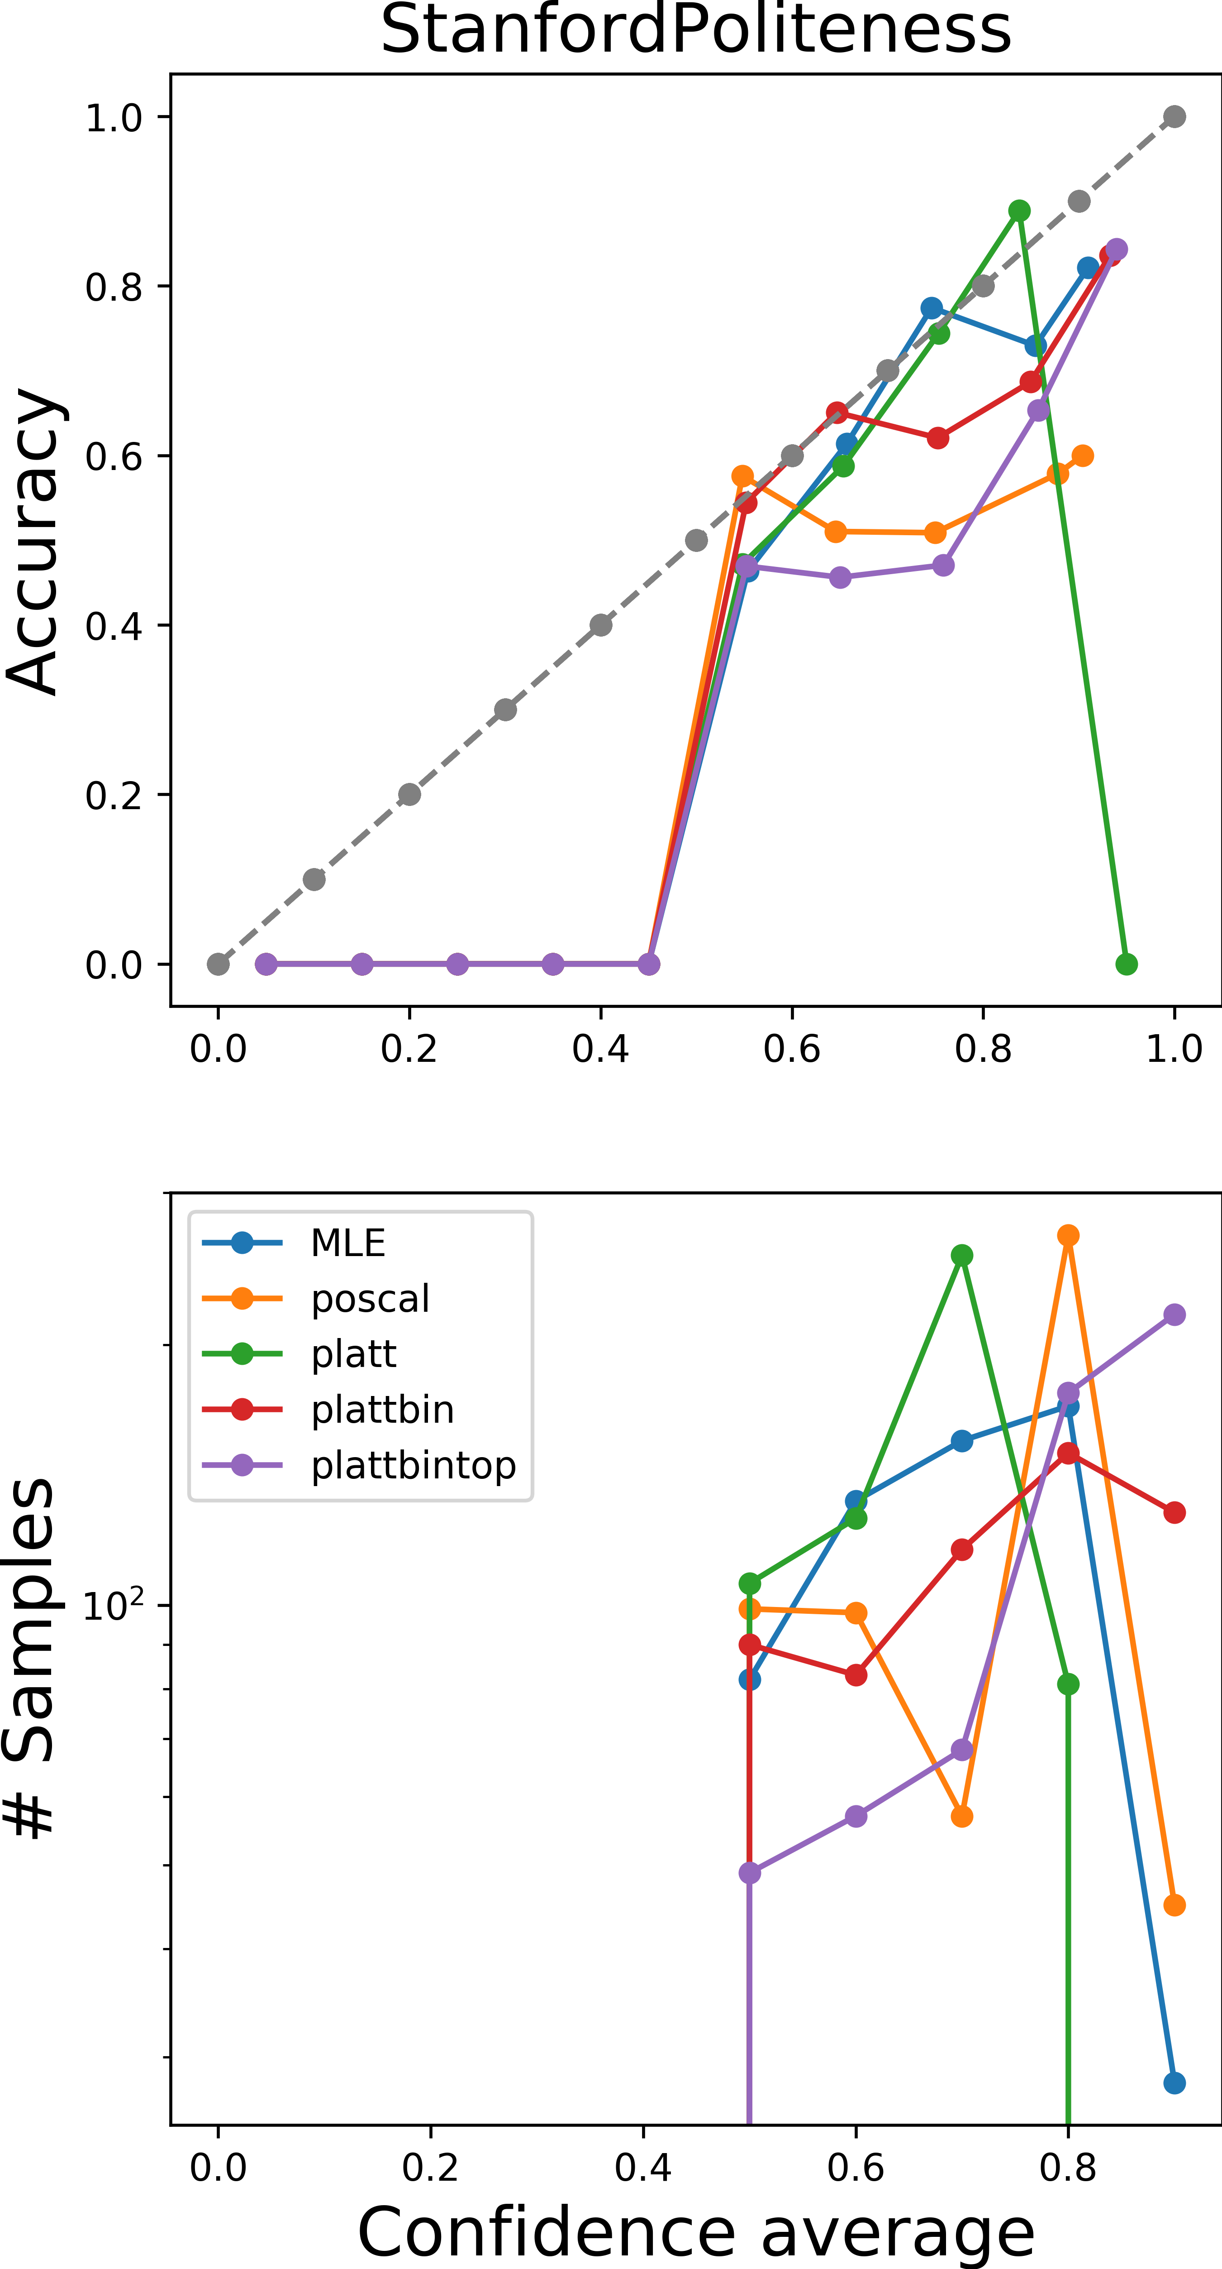
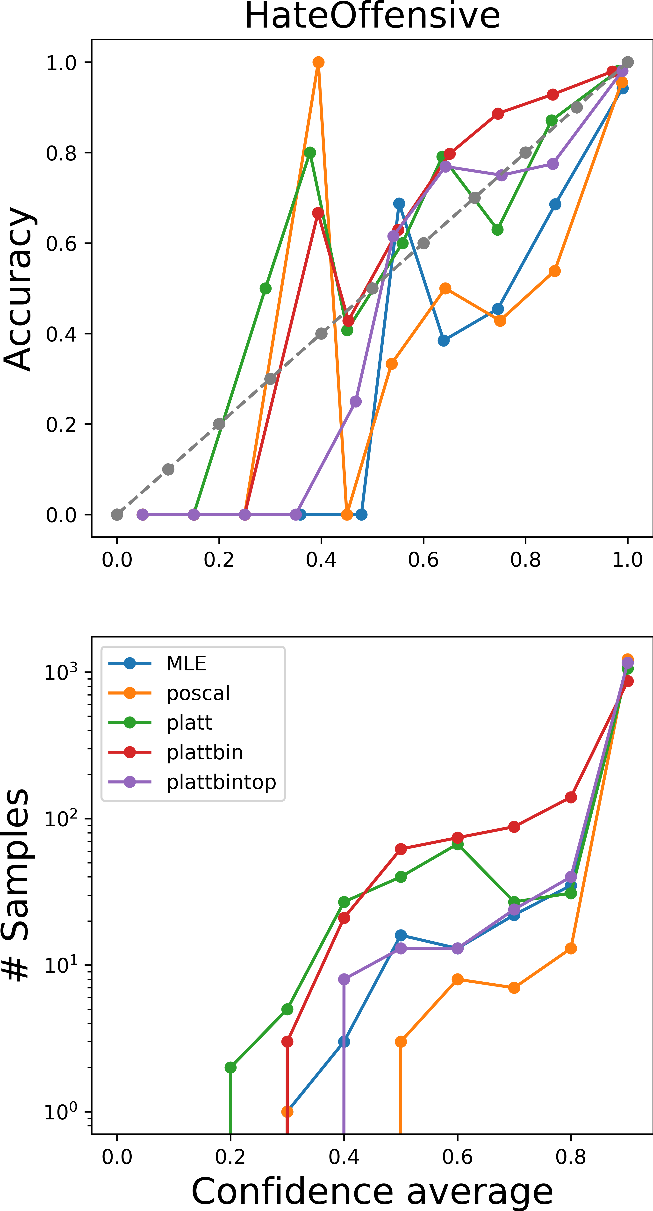
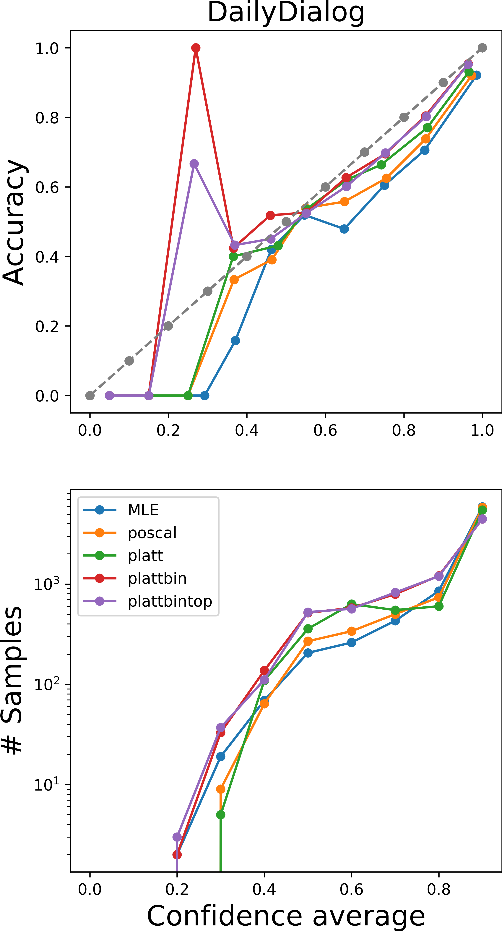
Calibration Plots
Classifier accuracy and number of samples vs average classification confidence in each bin
Reduction in accuracy by negliglible amount
Increase in number of samples with lower confidence
Superior sample efficiency
Notes:
We divide
test samples according to the most confident estimated
posterior into 10 bins and we plot the accuracy of the
classifier versus the average classification confidence in
each one of the bins and the number of samples versus
the classification confidence in the top and bottom row,
Respectively
the accuracy-confidence curve of a calibrated
classifier is close to the dashed grey curve in the top
Row
Platt-Binning and Platt-Binning-Top algorithms increase the
number of samples with lower classification confidence in
all three of the illustrated tasks
they only reduce classification
accuracy by a negligible amount and even increases the accuracy
for HateOffensive task
While the
ECE doesn’t improve in StanfordPoliteness, Platt-Binning
algorithm doesn’t increase the ECE as much as PosCal
Regularization.
This empricially proves the superior sample efficiency of this algorithm.

Slide 15
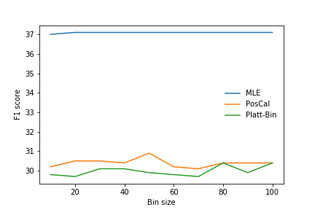
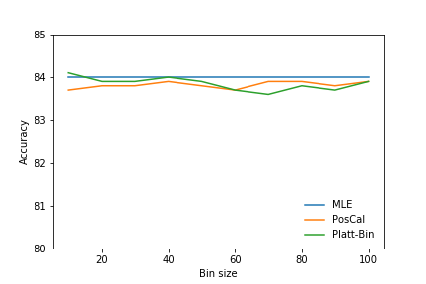
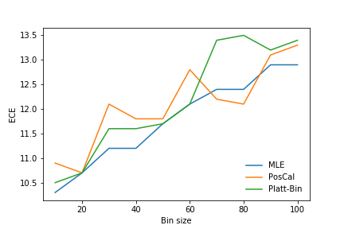
Effect of Bin size
Changing the bin size does not improve performance
Increasing trend in calibration error
Notes:
One plausible explanation
can be that as we increase the number of bins, we don’t have
enough samples per bin to estimate the empirical probabilities
accurately. Sine calibrated probabilities are used as an
estimation of the true probabilities of the classes in case of
PosCal and PB, it adds to the error if they are estimated
wrongly

Slide 16
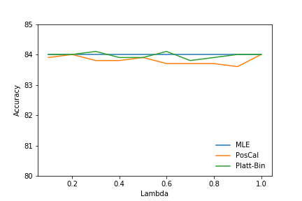
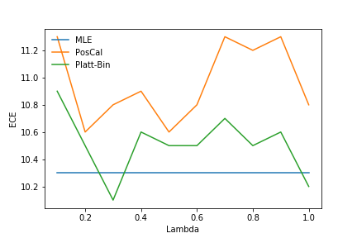
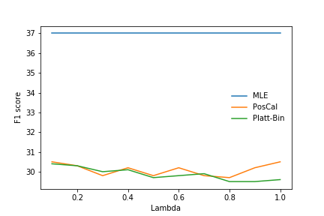
Effect of regularization factor
Notes:
The performance of PosCal and PB does not
change much with increasing regularization. We see a lot
of variation in ECE, however the trend is rather difficult to
draw any conclusions about the effect of regularization

Slide 17
Conclusion
Simple yet effective method called Platt-Binning calibrator for better posterior calibration
Lower sample complexity
Calibration while training
Better generalization
Reduction in calibration error
Increase in task performance
Extended as a regularizer for any other method

Slide 18
Acknowledgement
We are extremely grateful to Clara Meister, Prof. Ryan Cotterell and the entire team of Rycolab for equipping us with the necessay theoretical background required to understand, formulate and address the objective of this project.
Furthermore, we thank them for their indispensable guidance, especailly with regards to experimental evaluation and technincal support whenever required.
Overall, we would like to express our gratitude for their efforts in this otherwise difficult semester.

Slide 19
References
Chuan Guo, Geoff Pleiss, Yu Sun, and Kilian Q. Weinberger. 2017. On calibration of modern neural networks. In Proceedings of the 34th International Conference on Machine Learning, volume 70 of Proceedings of Machine Learning Research, pages 1321–1330, International Convention Centre, Sydney,Australia. PMLR.
T. Jung, D. Kang, H. Cheng, L. Mentch, and T. Schaaf, “Posterior calibrated training on sentence classification tasks,”arXiv preprint arXiv:2004.14500, 2020.
B. Zadrozny and C. Elkan. Obtaining calibrated probability estimates from decision trees and naive bayesian classifiers. In International Conference on Machine Learning (ICML), pages 609–616, 2001.
J. Platt. Probabilistic outputs for support vector machines and comparisons to regularized likelihood methods. Advances in Large Margin Classifiers, 10(3):61–74, 1999.
Naeini, Mahdi Pakdaman, Cooper, Gregory F, and Hauskrecht, Milos. Obtaining well calibrated probabilities using bayesian binning. In AAAI, pp. 2901, 2015.

